Slide 1
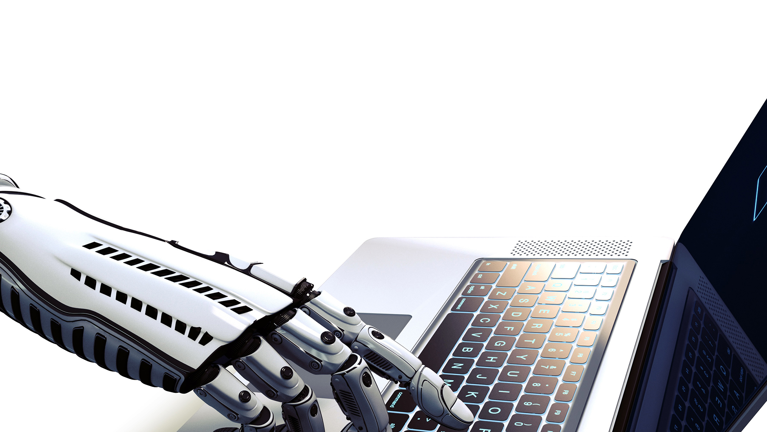
DIGITAL BUSINESS
AUTOMATION
What is RPA?
Robotic Process Automation is the innovative use of software to perform repetitive rules-based knowledge work across an organization as a substitute for, or aide to, human workers.
“Virtual Workers” replicate the specific actions a human would take while working with IT systems, the decisions they make, and the logical processes they follow, while interacting between different systems and applications.

Slide 2
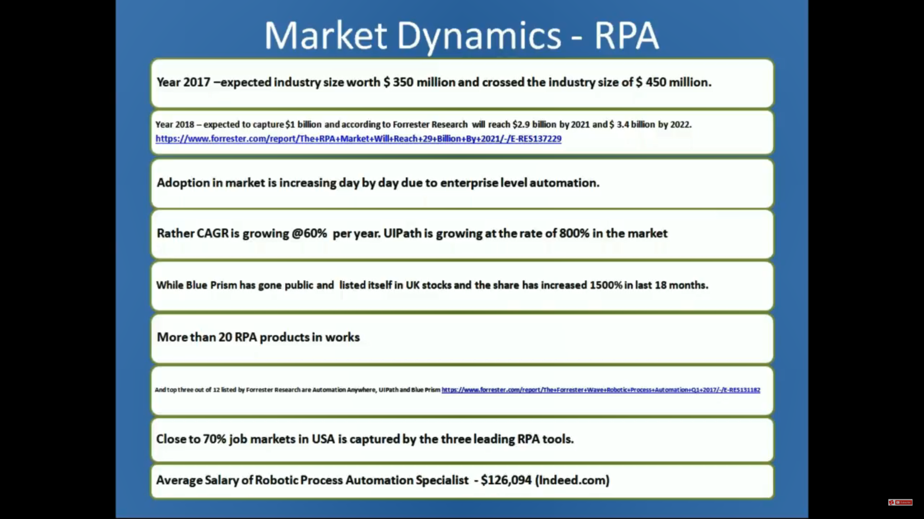
Why RPA RPA will reach $2.3bn next year and $4.3bn by 2022... as we revise our forecast upwards

Slide 3
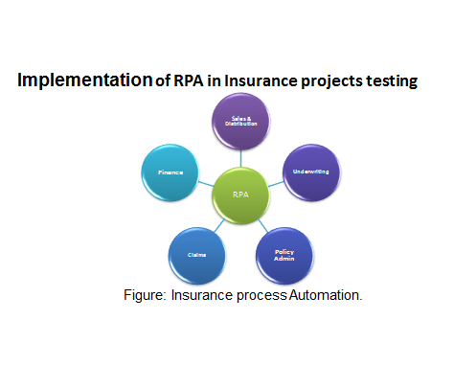

Slide 4
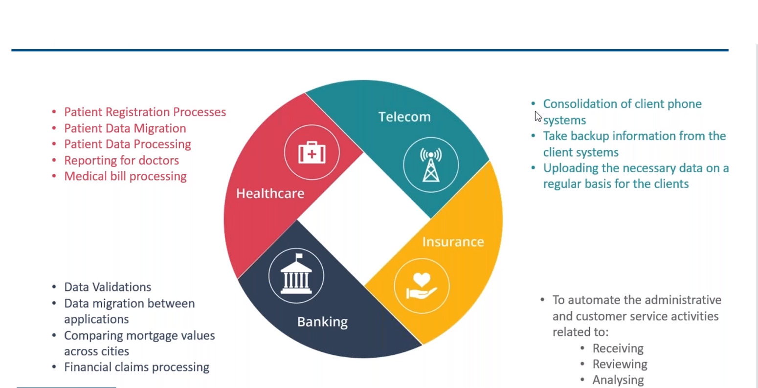

Slide 5
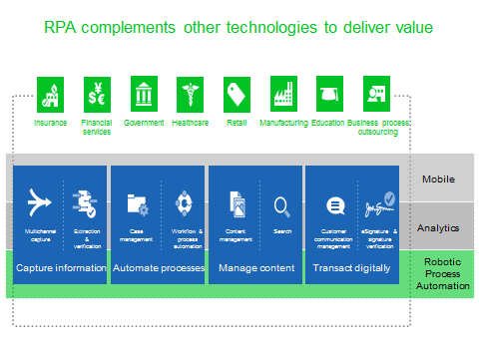

Slide 6
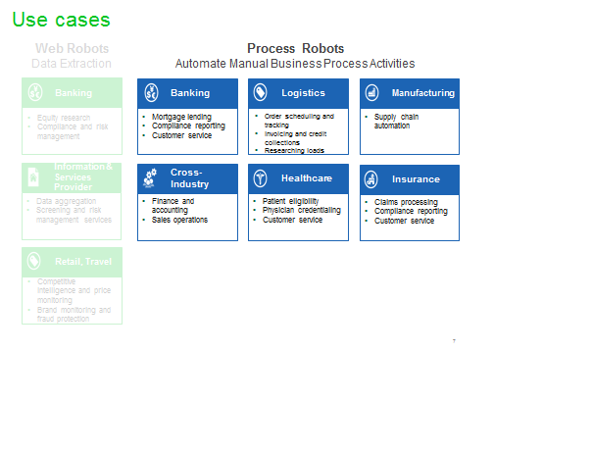

Slide 7
RPA Example
1. Data Entry
2. On Boarding System
3. My Project
4. Banking

Slide 8


45% of all work
activities can be automated
$2 trillion dollars
could be saved in workforce spending
6-9 Months
on average ROI for an RPA project
HOW IS RPA AFFECTING
THE WAY WE WORK?
94% of CEOs
that have incorporated RPA believe
that it has increased the productivity
By 2025
25% of jobs will be robotized

Slide 9
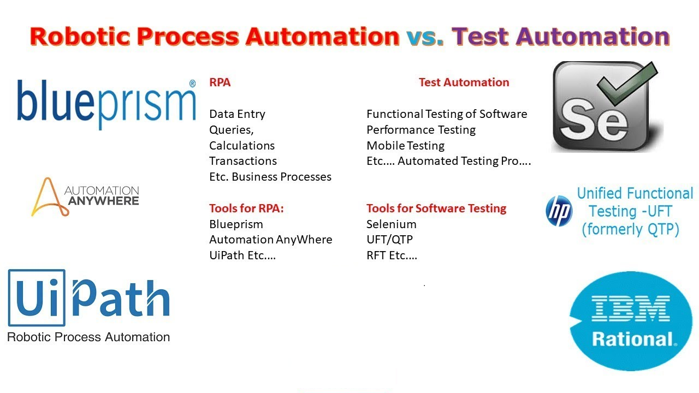

Slide 10
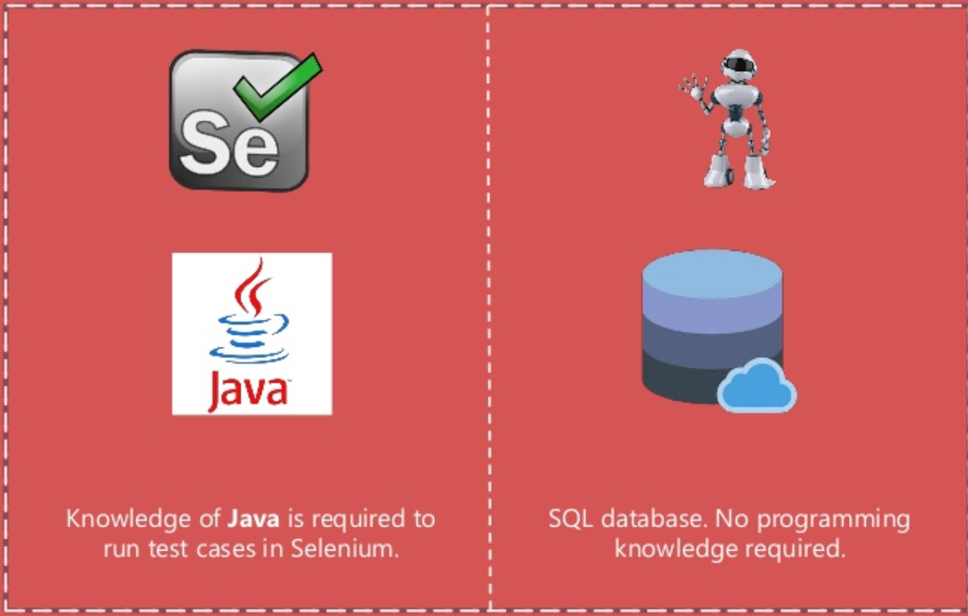

Slide 11
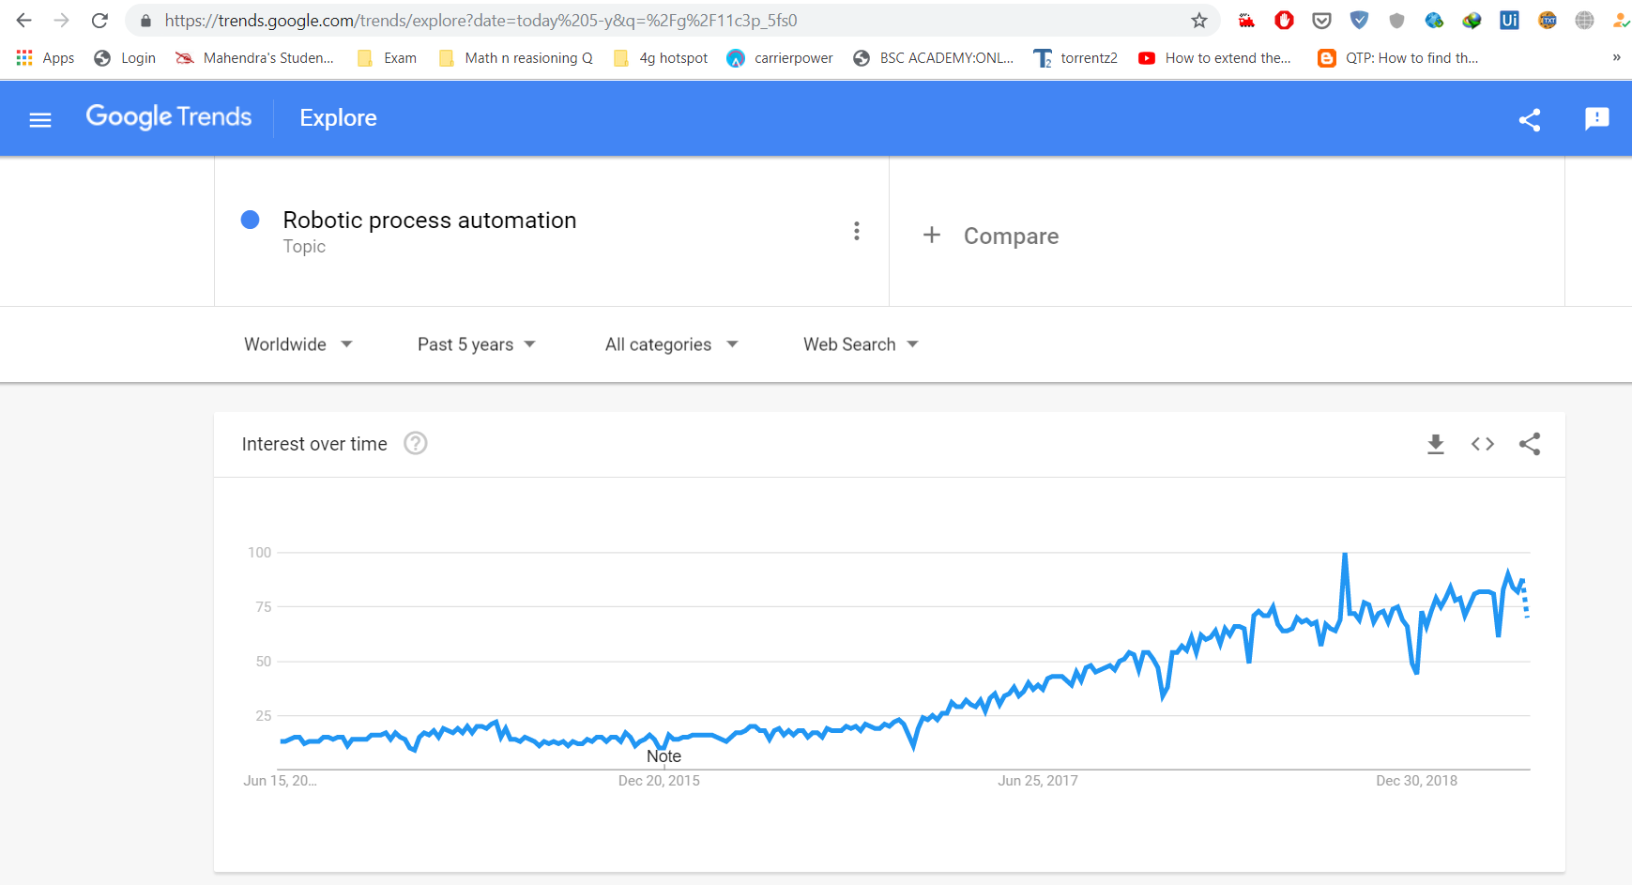

Slide 12
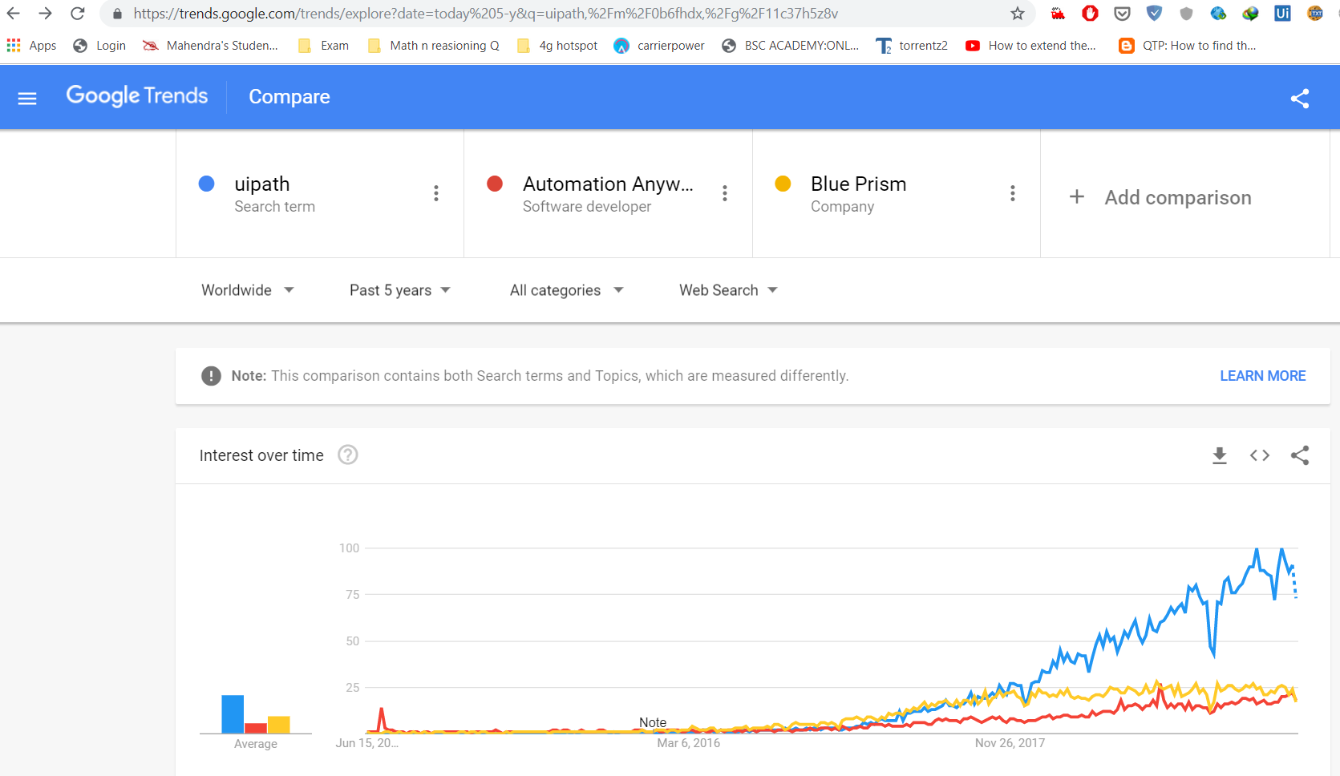

Slide 13

forrester research uipath

Slide 14
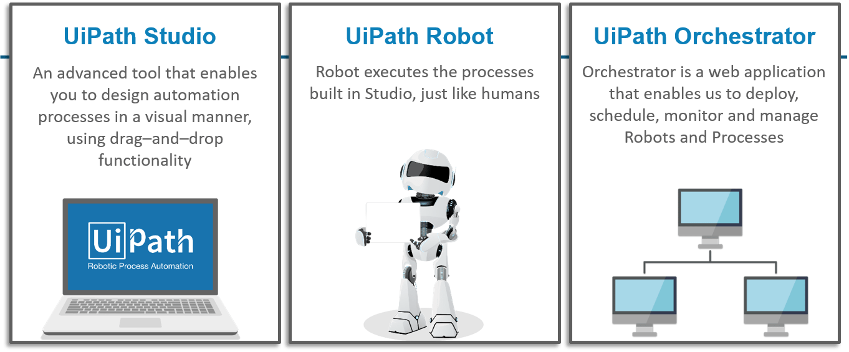
Uipath Component

Slide 15
RPA Demo
1. Data scarping
2. PDF Reading

Slide 16

RPA TYPICAL BUSINESS PROCESSES
RPA can learn from people, eventually taking over the processes that humans once completed, at a much faster pace.
Repetitive tasks Carried out 50-60
times a day
Process List
and Storage
Data Entry
Periodic reporting
and data analysis
Mass Email Generation
Archiving and extracting
Data Conversion
Conversion of data
format and graphics
ERP Transactions
ERP and other back
office transactions

